Slide 1
AI Chatbot for the Visually Impaired
Submitted in the partial fulfillment for the award of the degree of
BACHELOR OF ENGINEERING
IN
AIT CSE- CSBS
Submitted by:
ANSHIKA
21CBS1065
Under the Supervision of:
YOGIRAJ BHALE SIR
Department of AIT-CSE
DISCOVER . LEARN . EMPOWER

Slide 2
Outline
Introduction to Project
Problem Formulation
Objectives of the work
Methodology used
Results and Outputs
Conclusion
Future Scope
References

Slide 3
Introduction to Project
Title and Project Overview
The project’s significance

Slide 4
Title and Project Overview
Project Title: Accessible AI Chatbot for the Visually Impaired
Project Overview:
Developed using Next.js, Tailwind CSS, and TypeScript.
Features include Speech-to-Text and Text-to-Speech capabilities.
Additional features: unit converter, game hub, translator, file drop, live weather updates, and news services.
Targeted at visually impaired individuals.
Aims to address diverse needs of the visually impaired community.
4-month development timeline with a focus on accessibility.

Slide 5
The project’s significance
Digital Inclusion: The project is of paramount significance as it fosters digital inclusion, ensuring that visually impaired individuals have equal access to the digital world.
Quality of Life Enhancement: By improving the quality of life for visually impaired users, the project promotes independence and self-sufficiency in the digital age.
Educational and Employment Opportunities: It provides educational opportunities and enhances employability, empowering visually impaired individuals with knowledge and economic independence.
Social Inclusion: The project contributes to social inclusion by facilitating easier interactions, access to news, and participation in social activities.
Advancement in Assistive Technology: It represents a noteworthy advancement in assistive technology, showcasing how AI and chatbots can break down accessibility barriers and empower users.

Slide 6
Problem Formulation
The Challenges
Addressing the Challenges

Slide 7
The Challenges
Challenges for the Visually Impaired: Visually impaired individuals face significant challenges in their daily interactions with digital technology and information.
Limited Accessibility: Accessing digital content and services is hindered by a lack of accessibility. Websites, applications, and digital platforms are often designed without considering the needs of visually impaired users.
Fragmented Assistive Tools: The existing assistive technologies are fragmented and specialized, requiring users to navigate multiple applications, each serving a specific purpose. This fragmentation is inefficient.
Communication Barriers: Current digital communication primarily relies on text-based interactions, limiting the scope for natural language communication, which is essential for a more inclusive and intuitive user experience.
Inadequate Features: Many existing tools lack features such as unit conversion, gaming, translation, file management, live weather updates, and news services. These features are crucial for improving the daily lives.
Accessibility Gaps: Some existing solutions do not fully comply with accessibility standards, leading to accessibility gaps that hinder a seamless user experience.

Slide 8
Addressing the Challenges
Our Mission: In light of these challenges, our mission is to address these critical issues and create a solution that empowers visually impaired individuals in the digital realm.
A Unified and Comprehensive Approach: We aim to provide a unified, accessible, and comprehensive platform that combines various features and services into one accessible interface.
Natural Language Interaction: Our solution integrates Speech-to-Text and Text-to-Speech conversion to enable voice-based and natural language interactions, making digital communication more intuitive.
Enhancing Daily Life: We aim to provide features like unit conversion, gaming, translation, file management, live weather updates, and news services to enhance the daily lives of visually impaired individuals.
Accessibility at the Core: Our project places accessibility at its core, ensuring compliance with web accessibility standards like WCAG and offering an inclusive and user-friendly experience.

Slide 9
Objectives of the Work
Objective 1: Create a unified and accessible platform that offers a range of features and services to simplify digital interactions for visually impaired individuals.
Objective 2: Implement robust Speech-to-Text and Text-to-Speech functionalities, enabling voice-based interaction and enhancing communication for visually impaired users.
Objective 3: Facilitate natural language interactions through our chatbot, providing users with an intuitive and inclusive means of communicating with digital devices.
Objective 4: Enhance the lives of visually impaired individuals by offering practical features like unit conversion, gaming, translation, file management, live weather updates, and news services.
Objective 5: Ensure strict compliance with web accessibility standards to promote inclusivity and usability, making the digital world accessible to all users.

Slide 10
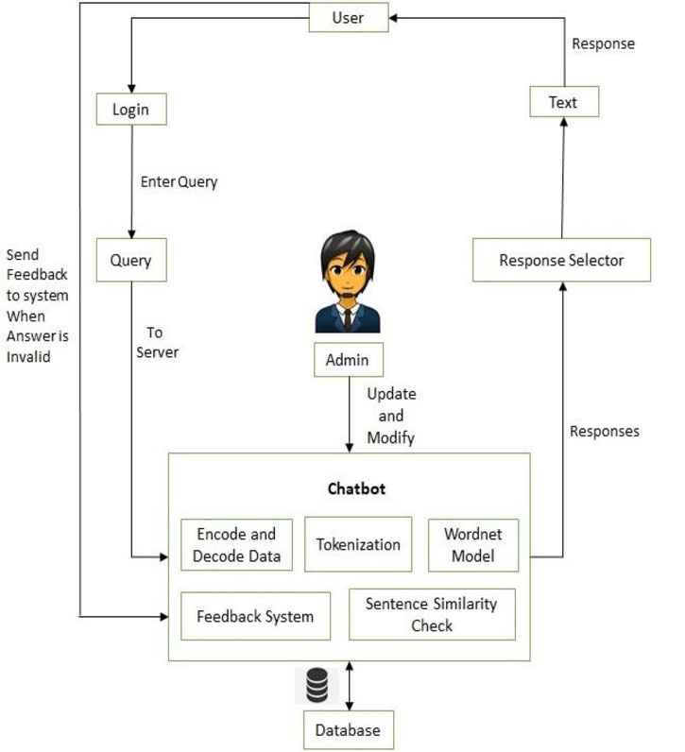
Methodology used
Methodology: Our project follows a structured development methodology to ensure efficiency and reliability in the creation of the Accessible AI Chatbot.
Workflow Overview: The project workflow consists of key stages, including research and requirements gathering, design, development, testing, deployment, and ongoing user feedback.
Flowchart: The flowchart illustrates the high-level workflow of the project, outlining the sequence of steps from inception to deployment.

Slide 11
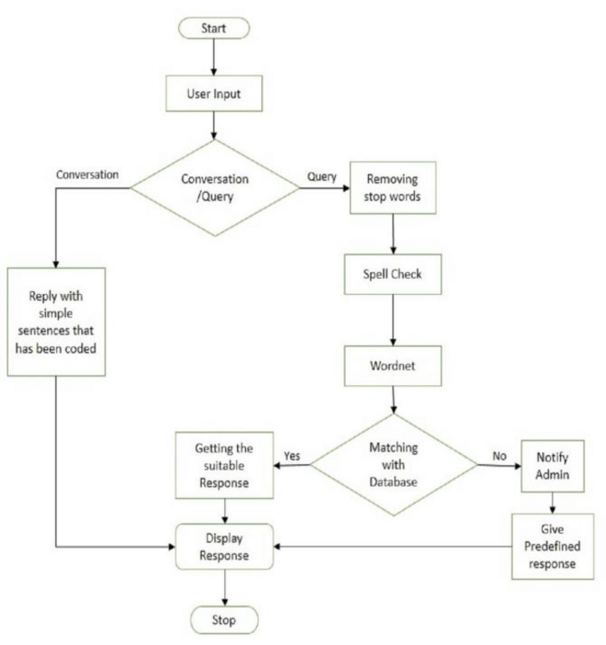
Project Modules
Module 1: User Interface Design: This module focuses on creating an accessible and user-friendly interface that accommodates both visually impaired and sighted users.
Module 2: Speech-to-Text and Text-to-Speech Integration: Implementing robust conversion capabilities to facilitate voice-based interactions and communication.
Module 3: Feature Development: Developing specific features like unit conversion, gaming, translation, file management, weather updates, and news services, all designed with accessibility in mind.
Module 4: Accessibility and Usability Testing: Ensuring compliance with accessibility standards and conducting user testing to validate the chatbot's accessibility and usability.
Module 5: Deployment and User Training: Preparing for deployment and offering user training to enable effective utilization of the chatbot.
Module 6: Monitoring and Feedback Loop: Implementing monitoring tools and mechanisms to collect ongoing user feedback, facilitating iterative improvements.

Slide 12
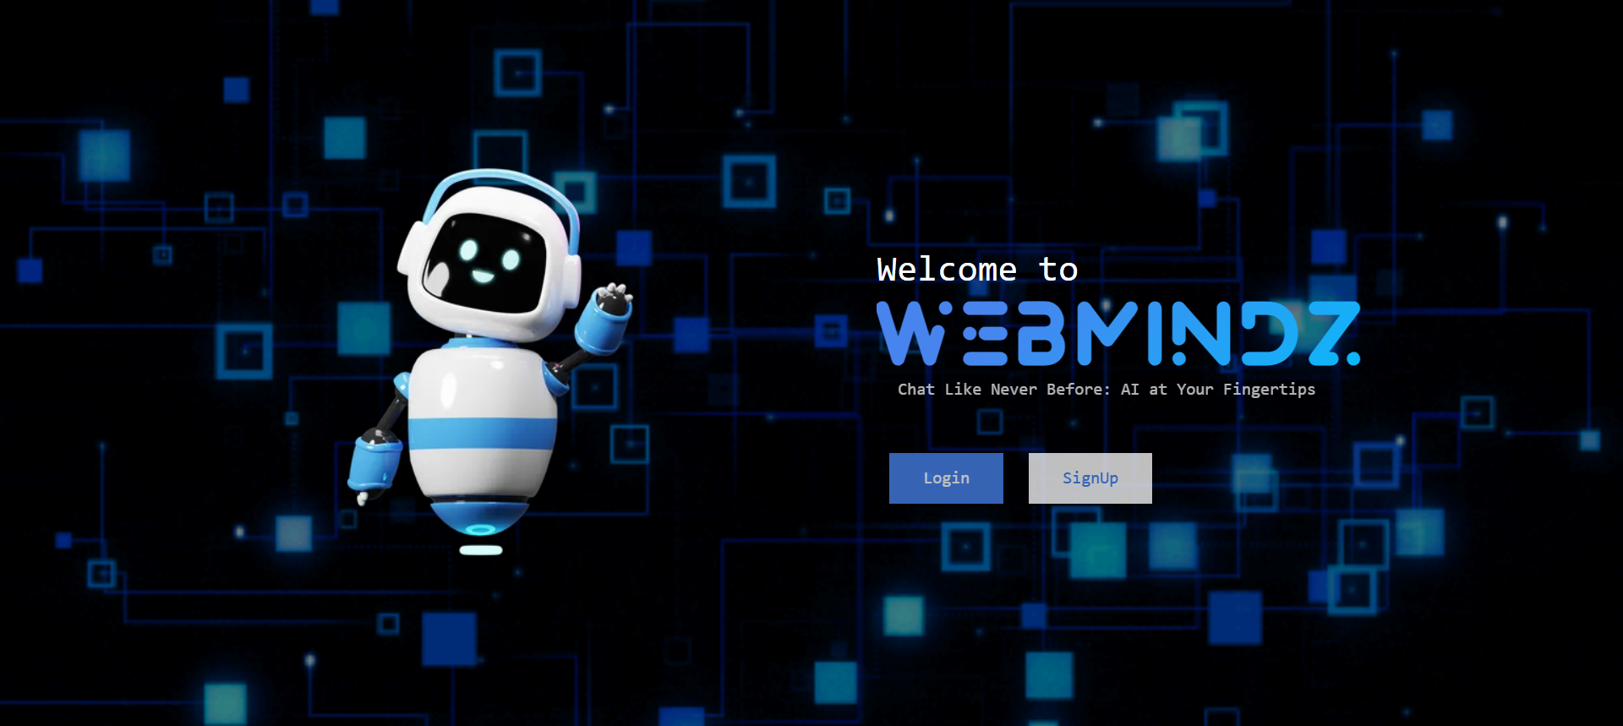
Results and Outputs
Landing Page

Slide 13
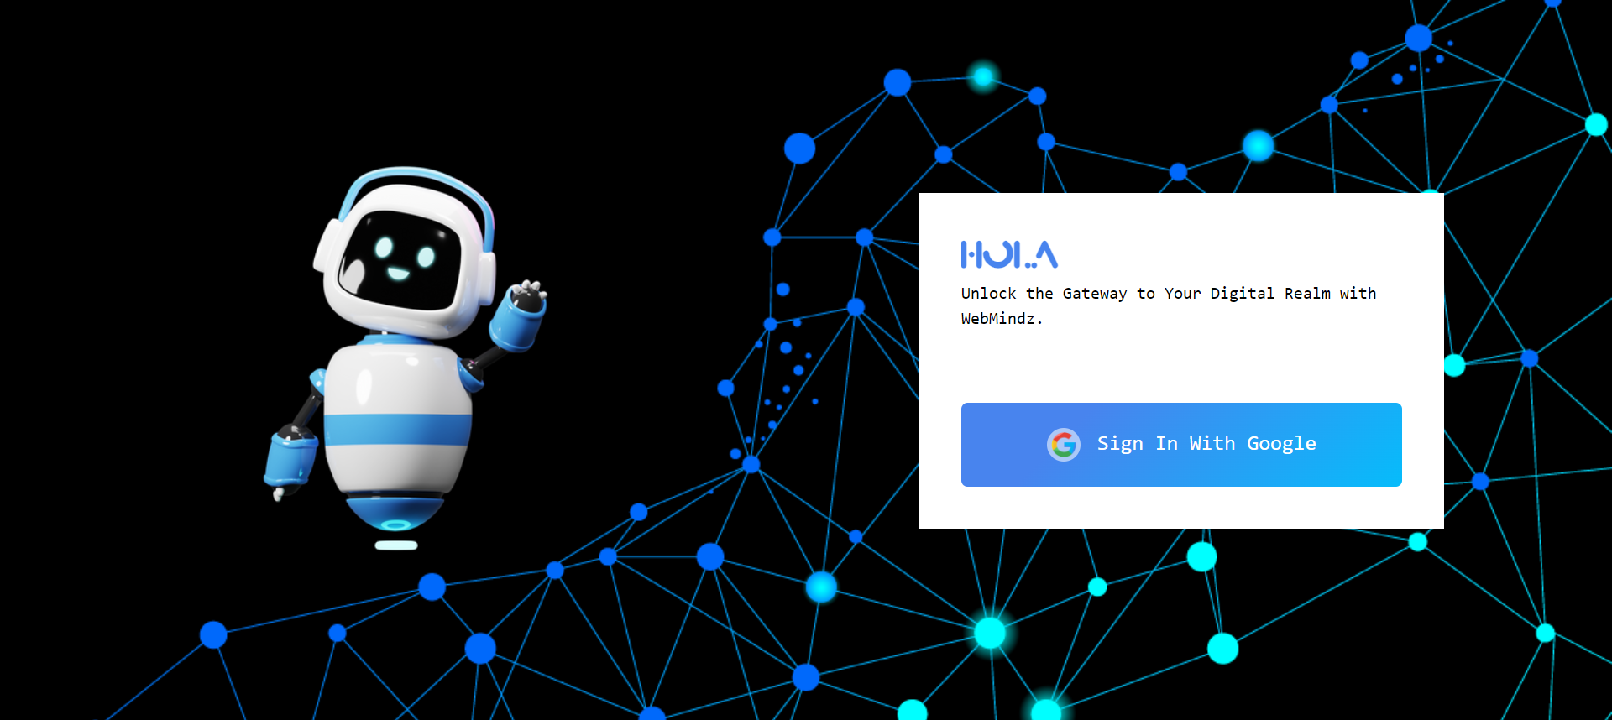
Login Page

Slide 14
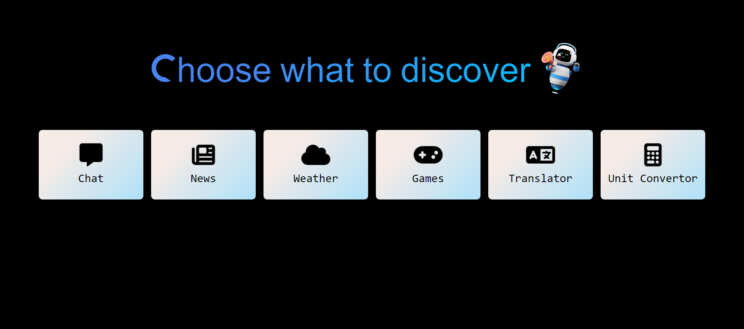
Options Page

Slide 15
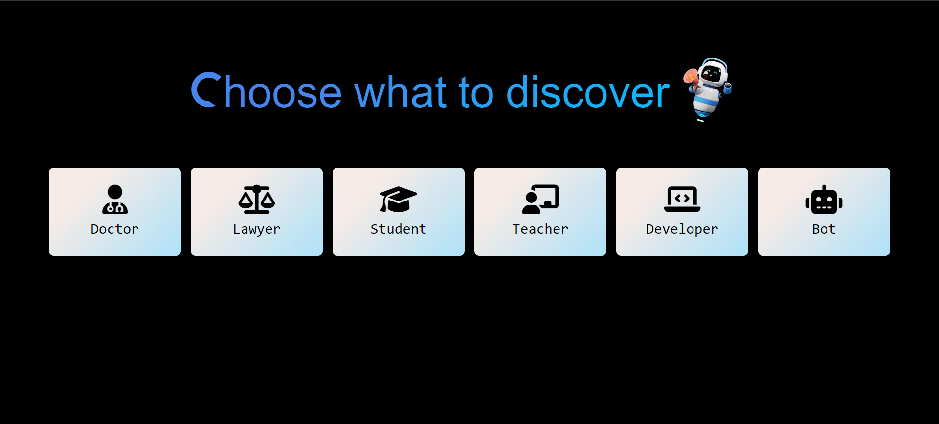
Chat Options Page

Slide 16
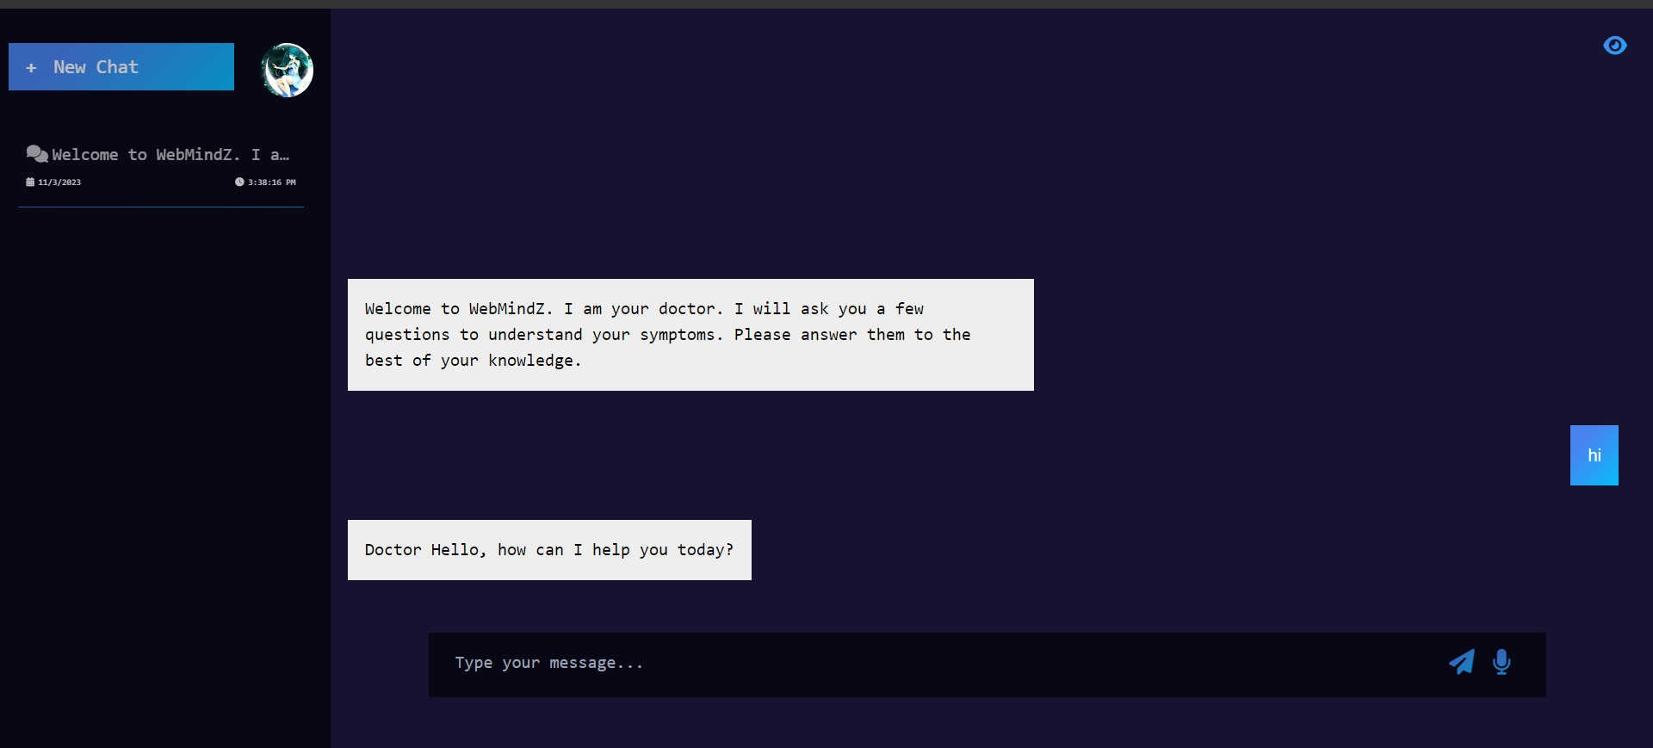
Chat Screen Page

Slide 17
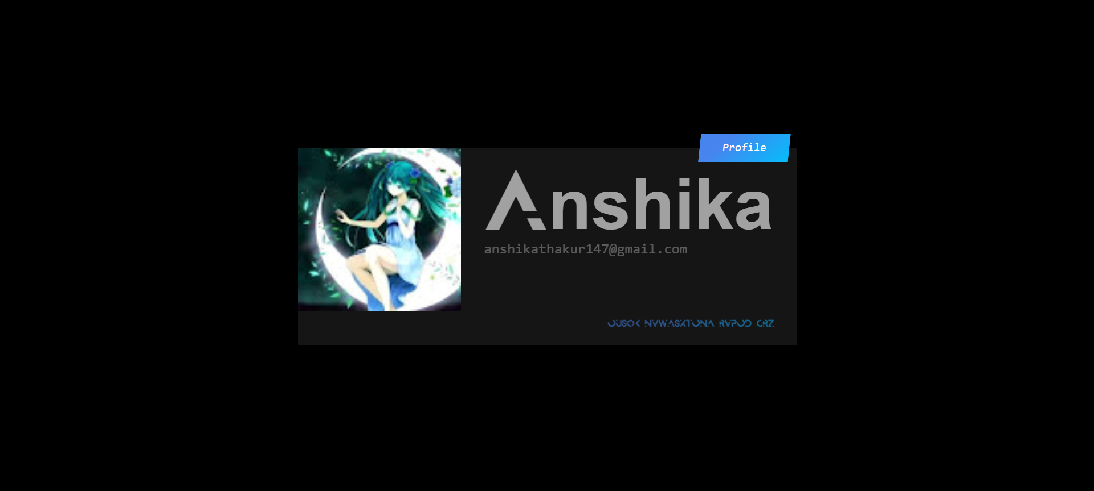
Profile Page

Slide 18
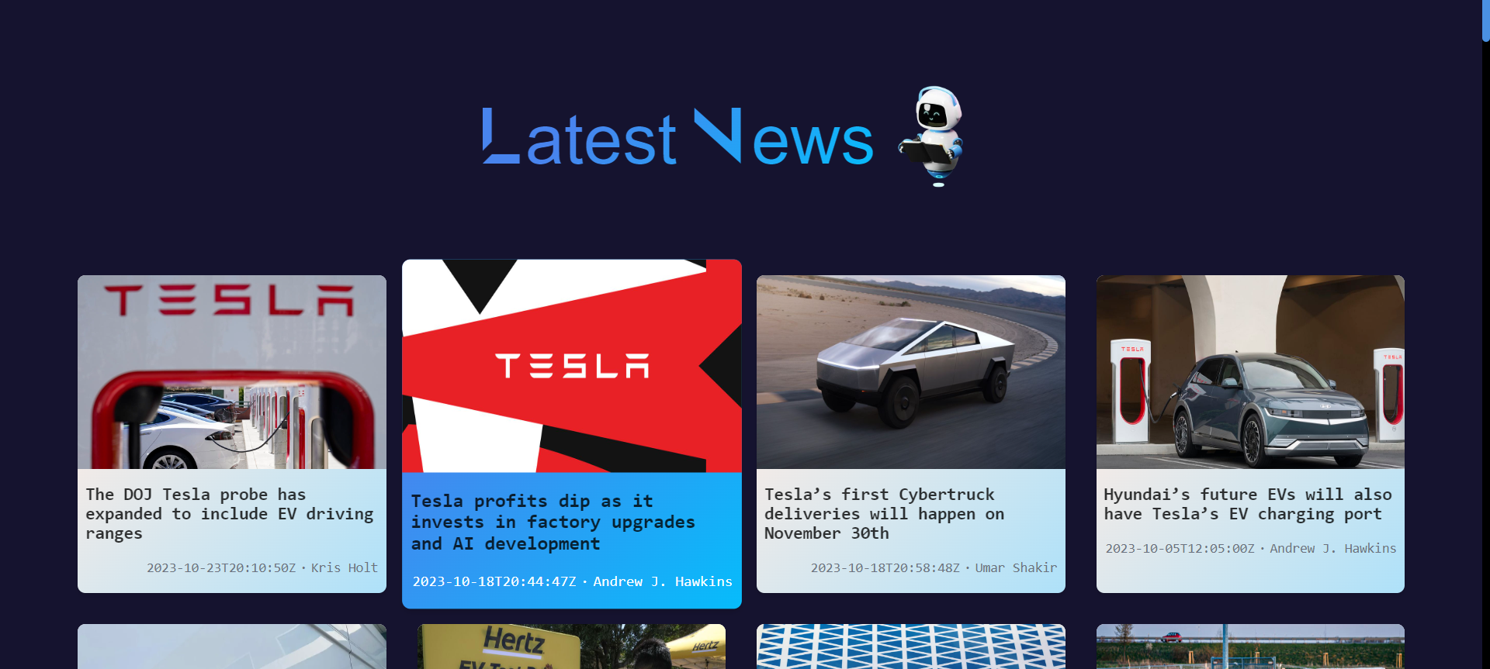
News Page

Slide 19
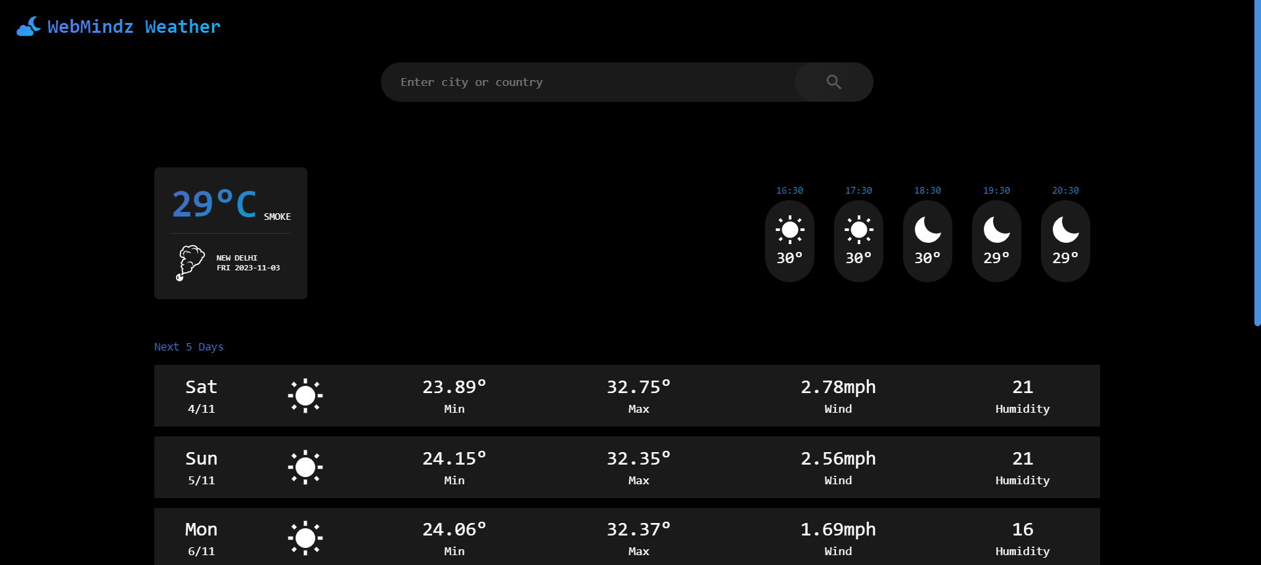
Weather Page

Slide 20
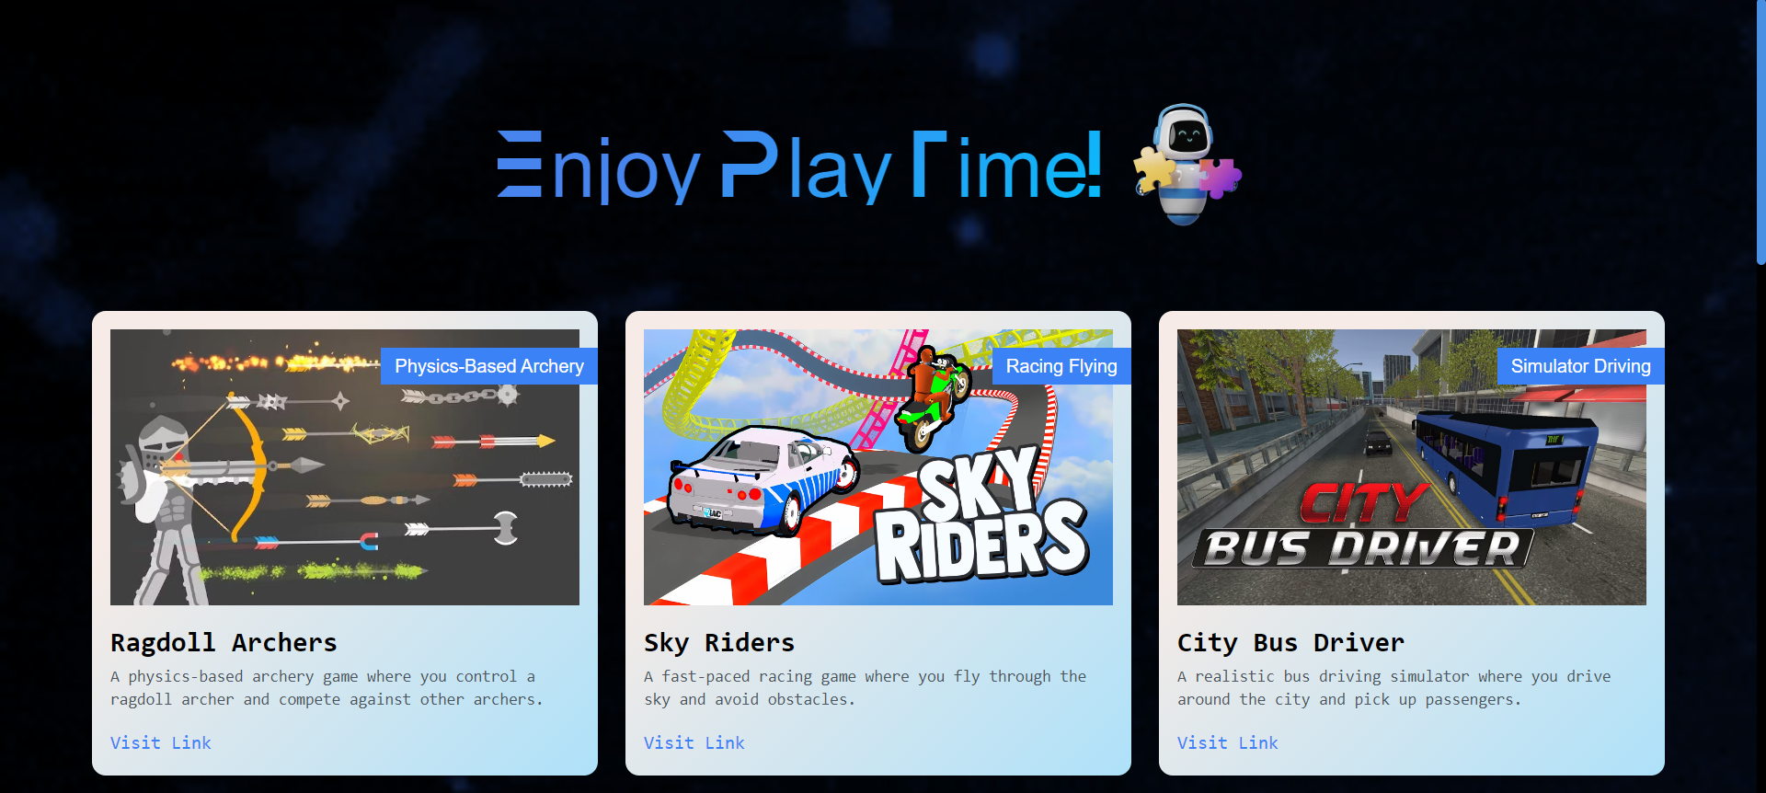
Games Page

Slide 21
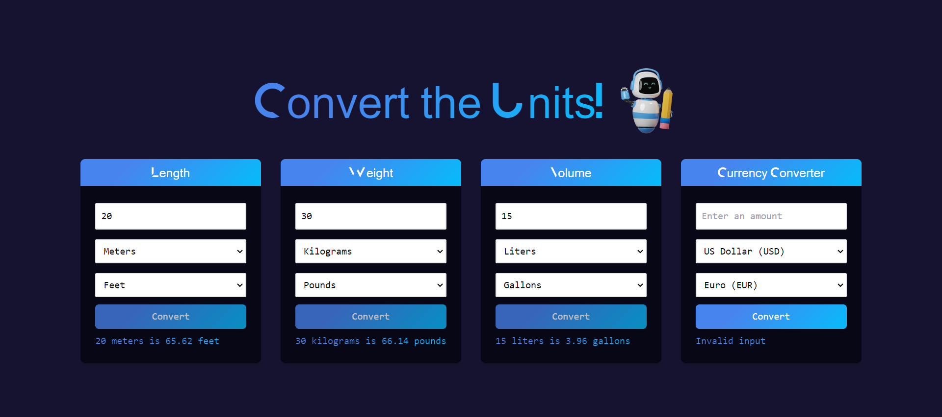
Unit ConvertorPage

Slide 22
Conclusion
Accessible AI Chatbot for the Visually Impaired" project significance:
Addresses accessibility and usability issues for the visually impaired online.
Offers a wide range of features for diverse user needs.
Technology and accessibility focus:
Developed using Next.js, Tailwind CSS, and TypeScript.
Adheres to web accessibility standards like WCAG.
Prioritizes user-friendly interface and natural language interaction.
Rigorous testing and user feedback:
Inclusive approach with user testing, accessibility evaluations, and iterative improvements.
Potential impact on users:
Dramatic improvement in the quality of life for the blind.
Eases routine tasks, promotes inclusion, and enhances digital navigation.
Overall project significance:
Admirable effort combining technology, usability, and accessibility.
Closes accessibility gaps and fosters a more welcoming digital environment for all users.

Slide 23
Future Scope
1. Expansion of Language Support:
Incorporate additional languages to reach a more diverse global audience.
Explore the integration of local dialects and languages for a more inclusive experience.
2. Advanced AI Capabilities:
Enhance the chatbot's natural language understanding for more sophisticated conversations.
Incorporate AI features like sentiment analysis to provide emotional support to users.
3. Integration of Navigation and GPS Services:
Develop location-based services to assist users in navigating their physical surroundings.
Provide information about nearby points of interest, public transportation, and navigation guidance.
4. Collaboration with Educational Institutions:
Partner with educational institutions to integrate the chatbot into e-learning platforms.
Develop educational content, tutorials, and resources tailored to the needs of visually impaired students.
5. User-Generated Content and Crowdsourcing:
Enable users to contribute content, voice commands, and customizations.
Create a community-driven environment for sharing accessibility tips and resources.

Slide 24
References
[1] Adamopoulou, Eleni, and Lefteris Moussiades. “An Overview of Chatbot Technology.” IFIP Advances in Information and Communication Technology, vol. 584, no. 1, 29 May 2020, pp. 373–383, www.ncbi.nlm.nih.gov/pmc/articles/PMC7256567/, https://doi.org/10.1007/978-3-030-49186-4_31.
[2] Di Lucca, Giuseppe A., and Anna Rita Fasolino. “Testing Web-Based Applications: The State of the Art and Future Trends.” Information and Software Technology, vol. 48, no. 12, Dec. 2006, pp. 1172–1186, https://doi.org/10.1016/j.infsof.2006.06.006.
[3] Ehsan, Adeel, et al. “RESTful API Testing Methodologies: Rationale, Challenges, and Solution Directions.” Applied Sciences, vol. 12, no. 9, 26 Apr. 2022, p. 4369, https://doi.org/10.3390/app12094369. Accessed 3 June 2022.
[4] Olive, Joseph P, and Mark Liberman. “Text to Speech—an Overview.” Journal of the Acoustical Society of America, vol. 78, no. S1, 1 Nov. 1985, pp. S6–S6, https://doi.org/10.1121/1.2022951. Accessed 22 Aug. 2023.
[5] Plekhanova, Julia. Evaluating Web Development Frameworks: Django, Ruby on Rails and CakePHP. Sept. 2009.

